Slide 1
Giacomo Cappon
Advanced Topics & Research

Slide 2
Outline
Recap
Backend development
Deployment & Flutter’s future
Research at DEI
IMPACT
Resources

Slide 3

Recap
Lesson 1
Lesson 5
Lesson 8
Lesson 10
Collaborate and version code
Create a layout
Make simple API calls
Implement user authentication
Lesson 2/3
Lesson 6
Lesson 9
Lesson 11
Get familiar with Dart
Navigate between screens
Fetch wearable data
Persist user data
Lesson 4
Lesson 7
Lesson 12
Understand Flutter’s principles
Manage the app state
Advanced stuff
Milestone #1
Milestone #2
Milestone #3
Do something with your fantasy

Slide 4
Outline
Recap
Backend development
Deployment & Flutter’s future
Research at DEI
IMPACT
Resources

Slide 5


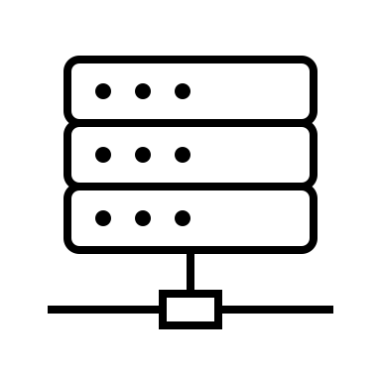



The network flow
Front-End
Back-End
DB
RESTful API
Messaging service
Server
Heavy computing service

Slide 6
Backend possibilities
Define APIs
Develop a custom messaging service
Cloud storage
Deploy heavy computing services
RESTful API
Heavy computing service
Messaging service
DB
Server

Slide 7



Backend - How to develop one?
The answer again is: do not reinvent the wheel, use something already developed.
There are a lot of solutions (each based on a different programming language), you just have to choose what’s the best for your needs and requirements.
Here’s some of the most popular backend frameworks:
Django: Python
Conduit: Dart
Node.js: Javascript
…

Slide 8
Outline
Recap
Backend development
Deployment & Flutter’s future
Research at DEI
IMPACT
Resources

Slide 9


The last step: Deploy
At some point, one would like to deploy the app on Apple App Store (iOS) or Google Play Store (Android)

Slide 10
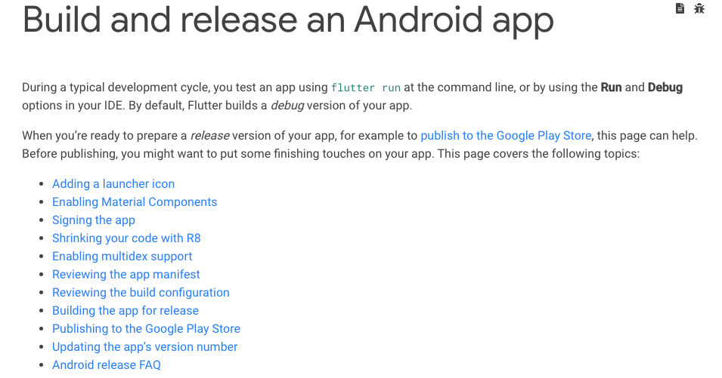
Deploy in Android
https://docs.flutter.dev/deployment/android

Slide 11
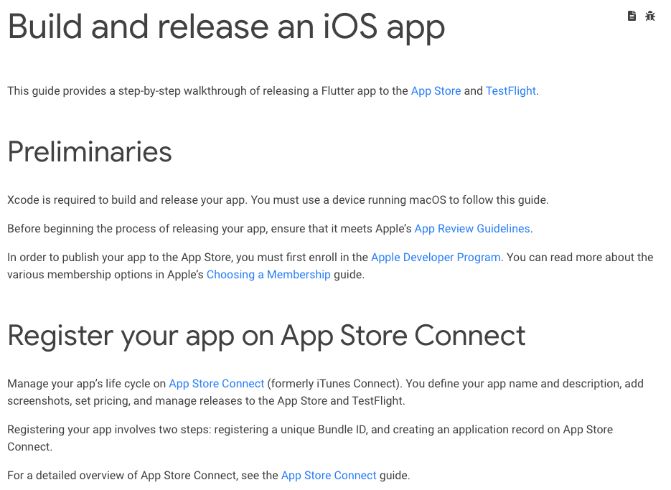
Deploy in iOS
https://docs.flutter.dev/deployment/ios

Slide 12

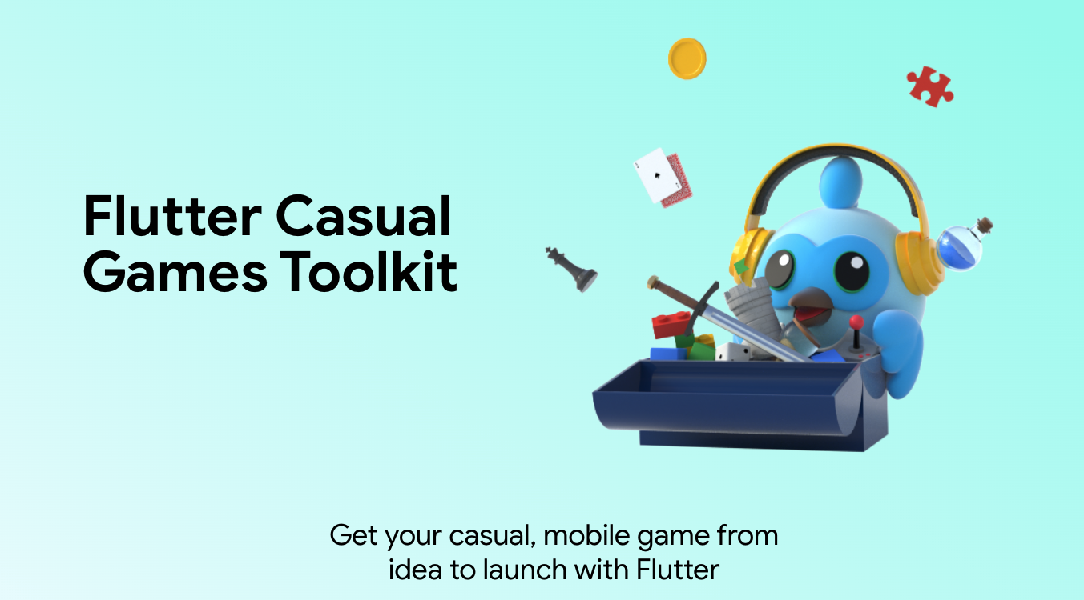
News from Flutter 3: Casual Games Toolkit
https://flutter.dev/games

Slide 13
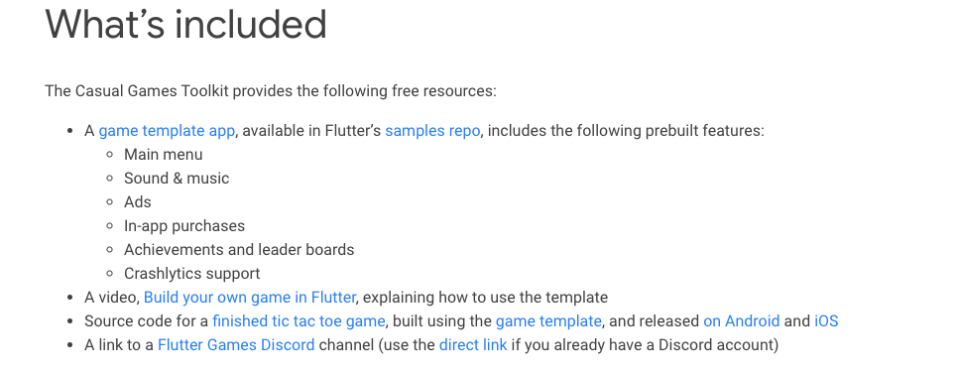
Casual Games Toolkit
https://docs.flutter.dev/resources/games-toolkit

Slide 14
Outline
Recap
Backend development
Deployment & Flutter’s future
Research at DEI
IMPACT
Resources

Slide 15
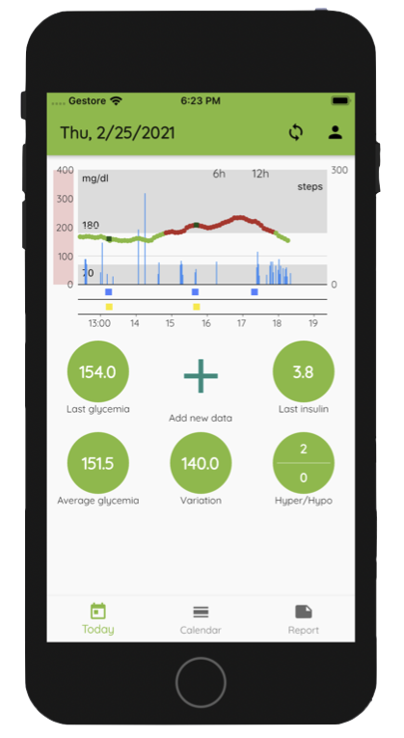
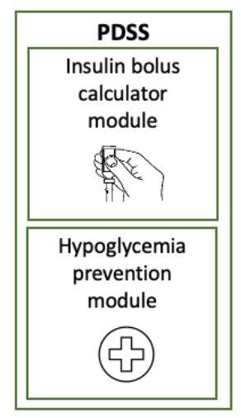
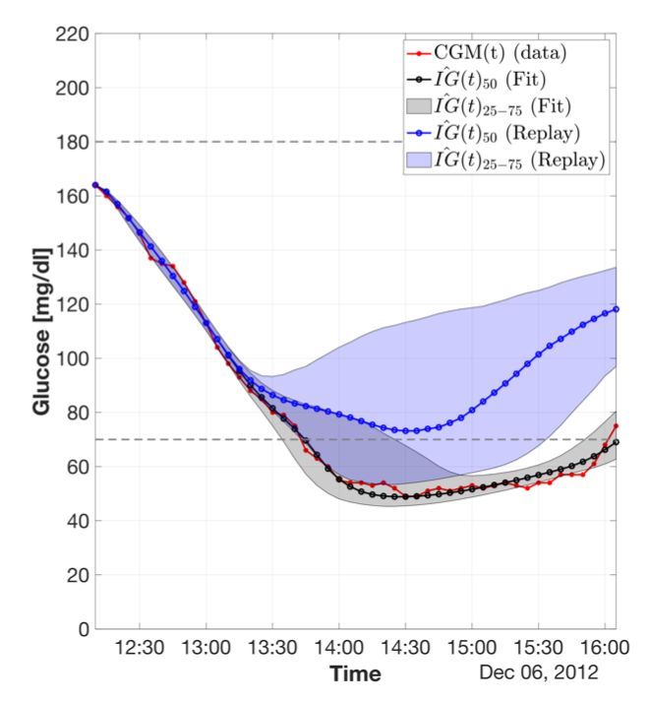
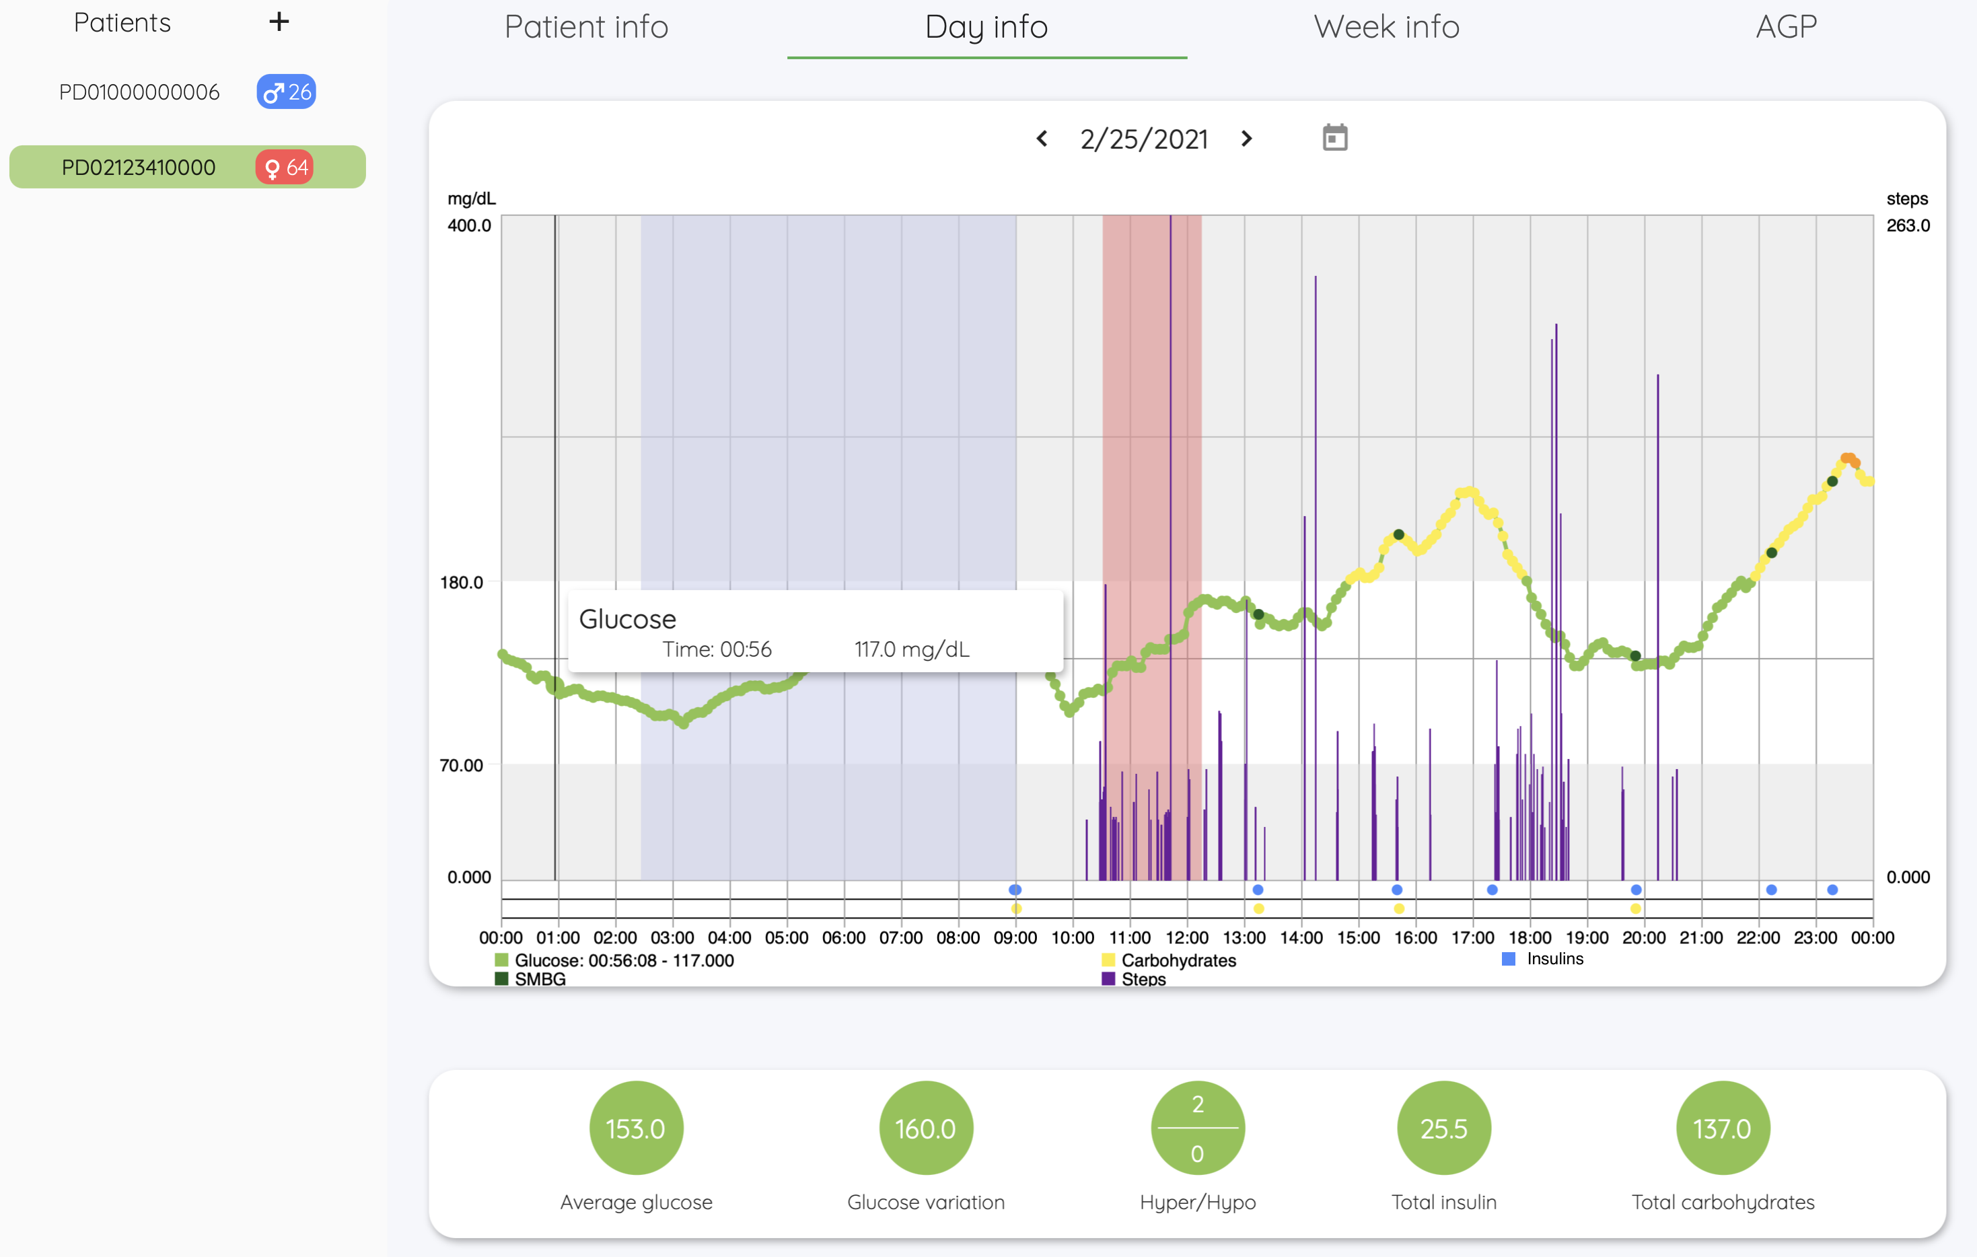
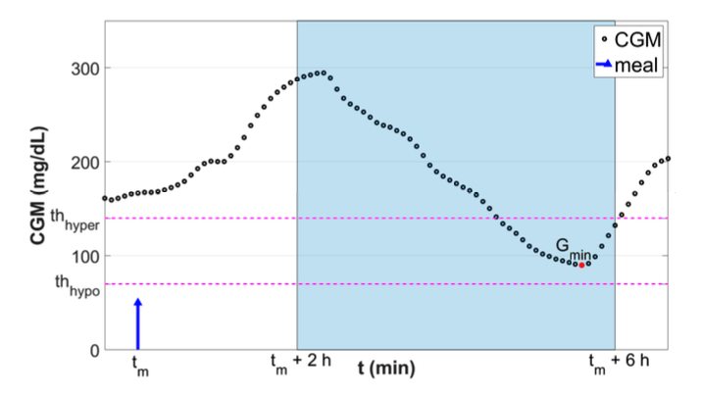
Research @ DEI
Decision support systems
Prediction algorithms
Clustering and stratification strategies
Event detection
Digital therapeutics solutions
…(much more)

Slide 16
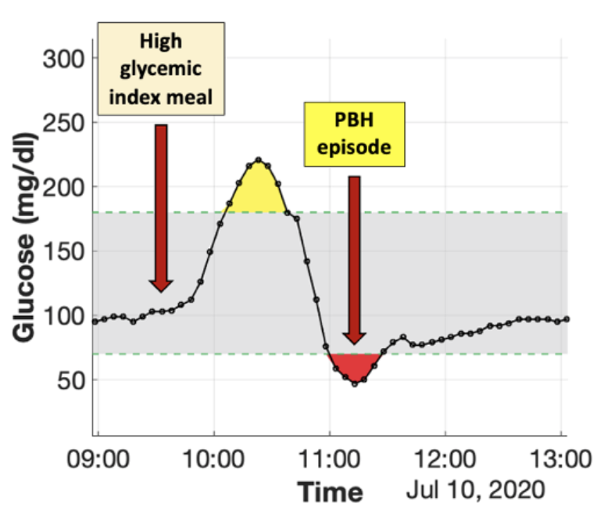
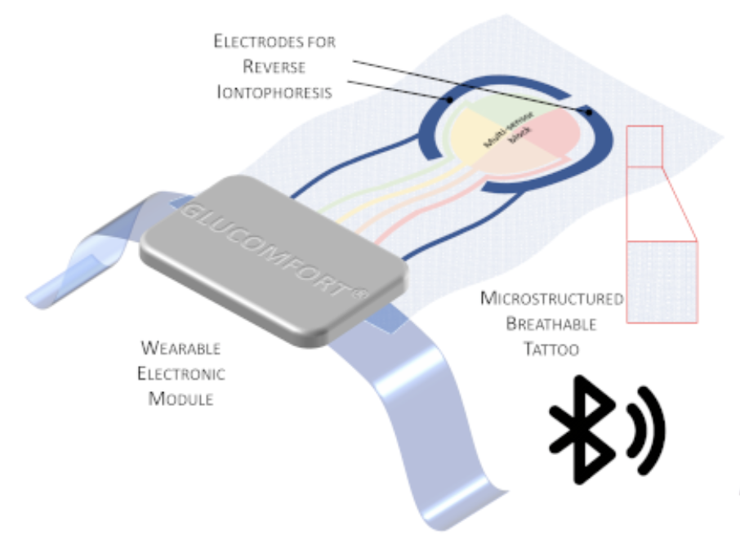
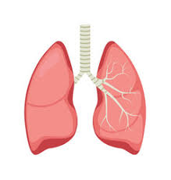
Active projects
Development and clinical assessment of a personalized decision support system for postbariatric hypoglycemia management in people who underwent bariatric surgery
GLUCOMFORT – Development of a noninvasive tattoo-based continuous GLUCOse Monitoring electronic system FOR Type-1 diabetes individuals
BREATHE - Big data, internet-of-things and aRtificial intelligence to study the impact of personal Exposure to Air pollution on asTHma Exacerbations

Slide 17
Outline
Recap
Backend development
Deployment & Flutter’s future
Research at DEI
IMPACT
Resources

Slide 18

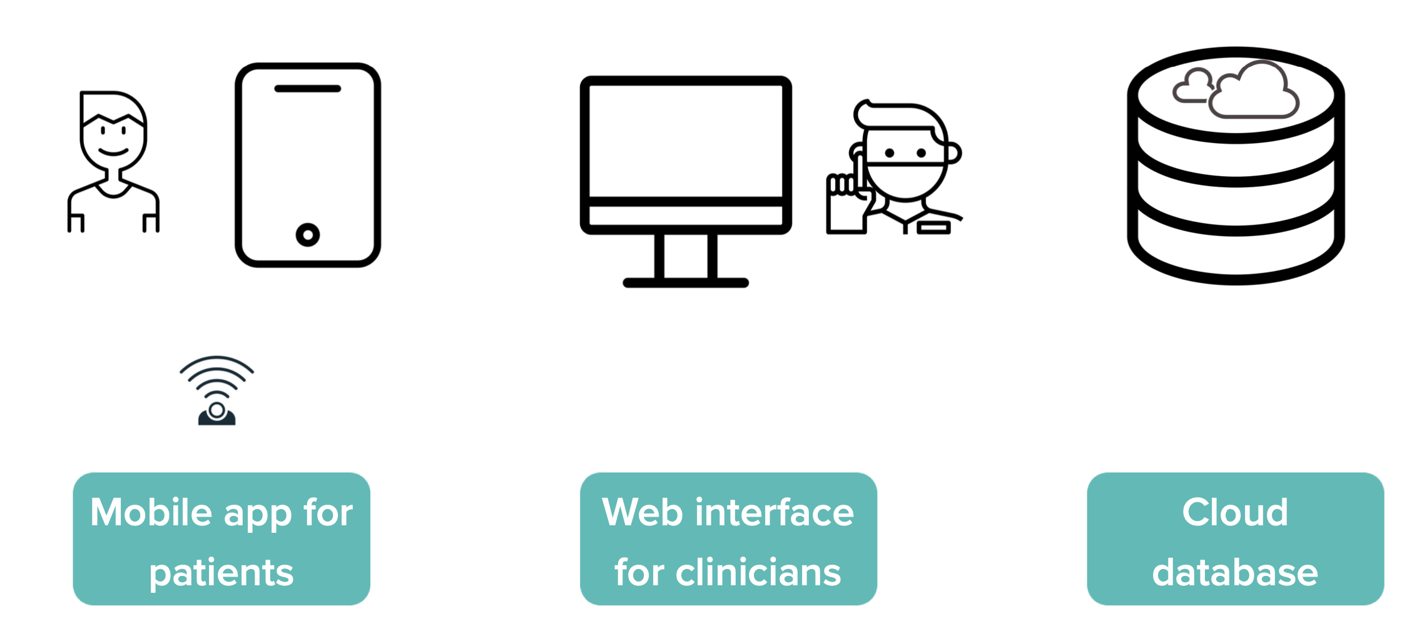
IMPACT Platform
IMPACT* is a platform that will play a key role in these projects. Here’s the key features:
*G. Cappon, L. Cossu, F. Boscari, D. Bruttomesso, G. Sparacino, A. Facchinetti. An Integrated Mobile Platform for Automated data collection and real-time patient monitoring in diabetes clinical trials. Journal of Diabetes Science and Technology, 2021.

Slide 19
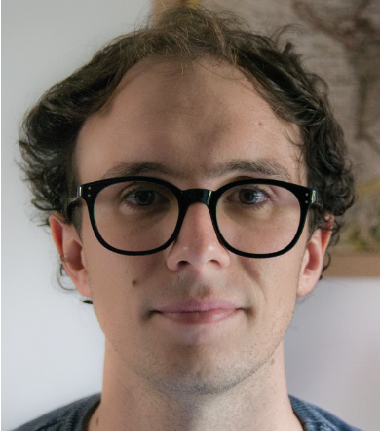
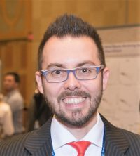
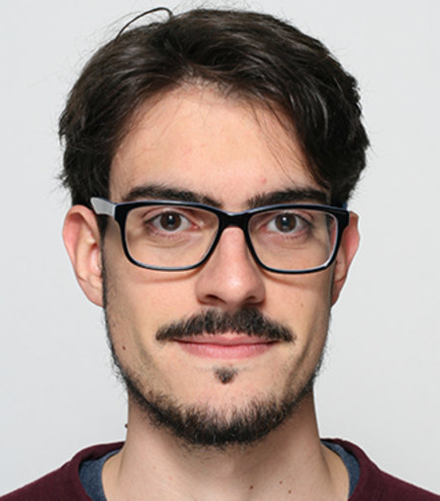
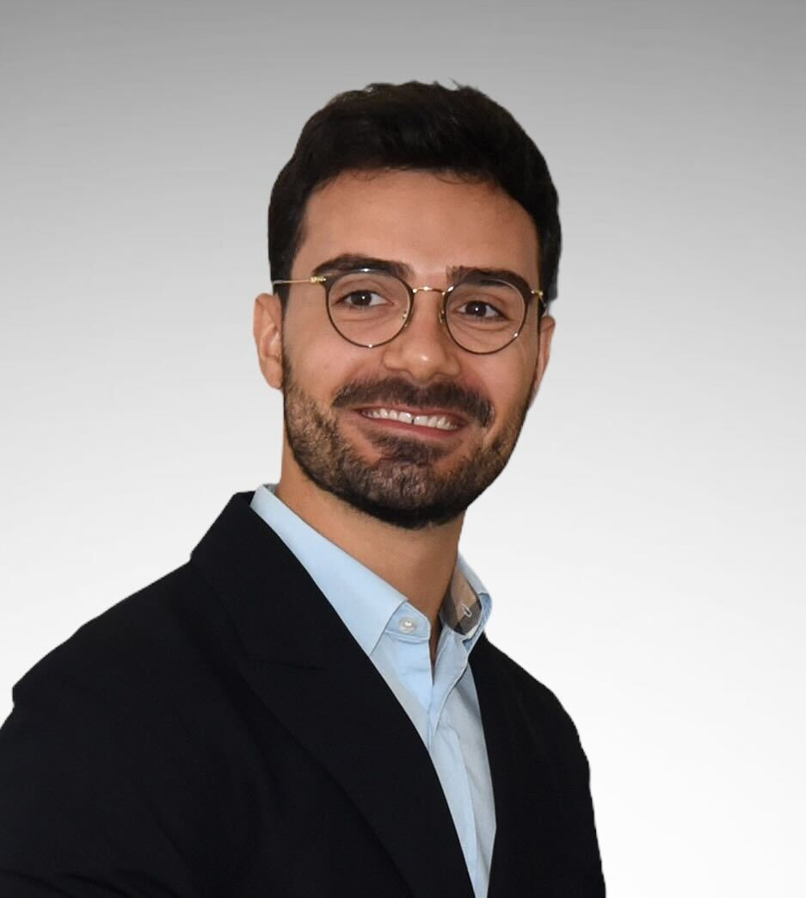
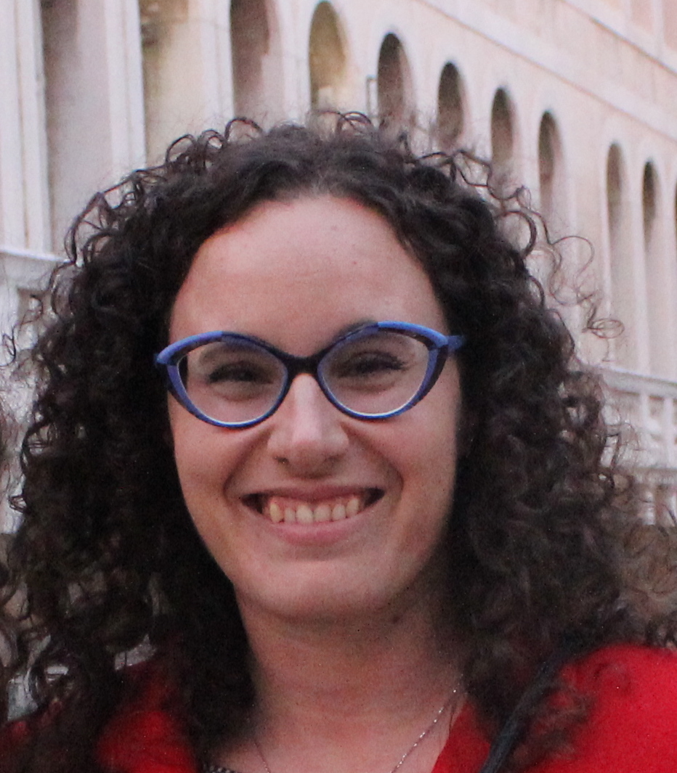
The IMPACT team
Scientific Advisors
Core Team
Giacomo Cappon Post-doc fellow
Andrea Facchinetti Associate Professor
Luca Cossu 1st year PhD student
Martina Vettoretti Assistant Professor
Michele Atzeni 1st year PhD student

Slide 20

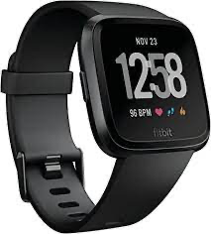





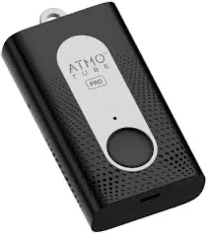




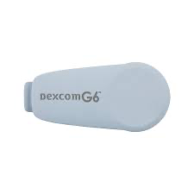


IMPACT structure
Database
RESTful APIs
Cloud server
Mobile app
Remote monitoring interface
Portable/Wearable devices

Slide 21
IMPACT: Live DEMO
Database
RESTful APIs
Cloud server
Mobile app
Remote monitoring interface
Portable/Wearable devices

Slide 22
IMPACT: Live DEMO
Database
RESTful APIs
Cloud server
Mobile app
Remote monitoring interface
Portable/Wearable devices

Slide 23
IMPACT: Work to do
Expand fitbitter and integrate it in IMPACT (difficulty: medium)
Gamify IMPACT (difficulty: medium)
Explore and add ”mindfulness” capabilities
Integrate the OpenFoodFacts API
Explore and integrate open source API of air quality
Integrating and managing geolocation
Study and analyzing IMPACT compliance to regulatory
Integration of new wearable devices via Bluetooth/API
…

Slide 24
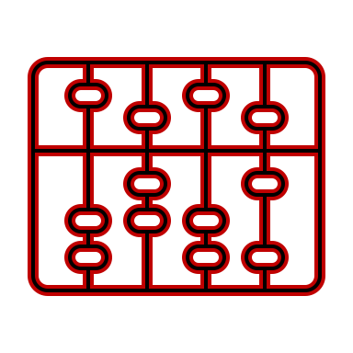
A lot more…
An example: Development of Digital Tools for education in type 1 diabetes
RESTful APIs
Mobile app
Simulation Model of T1D

Slide 25
Outline
Recap
Backend development
Deployment & Flutter’s future
Research at DEI
IMPACT
Resources

Slide 26
Resources
*G. Cappon, L. Cossu, F. Boscari, D. Bruttomesso, G. Sparacino, A. Facchinetti. An Integrated Mobile Platform for Automated data collection and real-time patient monitoring in diabetes clinical trials. Journal of Diabetes Science and Technology, 2021.
https://gcappon.github.io/files/cappon_jdst_2021.pdf

